Slide 1
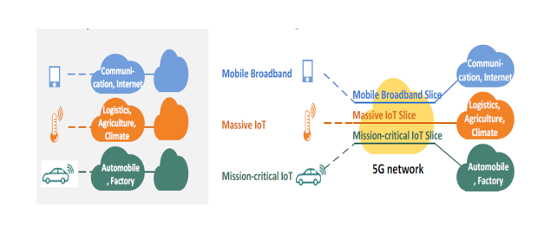

Slide 2

Network Slice Selection Function (NSSF)
Authentication Server Function (AUSF)
Unified Data Function (UDM)
Application Function (AF)
N13
N22
N12
N8
N10
N5
Access & Mobility Function (AMF)
Session Management Function (SMF)
Policy Control Function (PCF)
N11
N7
Control Plane
N1
N2
N4
Data Plane
External Data Network
UE
Data Network (DN)
5G RAN
gNode-B
User Plane Function (UPF)
Uu
N3
N6

